Slide 1



SEG3125: Lab 5
1
Design Principles
Presented by TA Gurdarshan and TA Anisha, 2024-02-09
Faculté de génie | Faculty of Engineering
uOttawa.ca

Slide 2
Deadlines
2
The deadline for lab 5 is February 16th at 11:59PM
This lab is worth 3%

Slide 3
Introduction
3
This lab, you are going to improve your website from lab 4 and
continue your design in relation to Don Norman’s Design Principles
Visibility
Affordance
Mapping
Consistency
Feedback
Constraints
You are going to use a JavaScript Library: jQuery

Slide 4
Tutorial
4
jQuery Tutorial
https://www.w3schools.com/jquery/default.asp
Don Norman Design Principles
https://medium.com/@sachinrekhi/don-normans-
principles-of-interaction-design-51025a2c0f33

Slide 5
Lab 5 Introduction
5
In this lab, you must continue the development of your service business website that you started last week, either a hair salon or a bike repair shop.

Slide 6
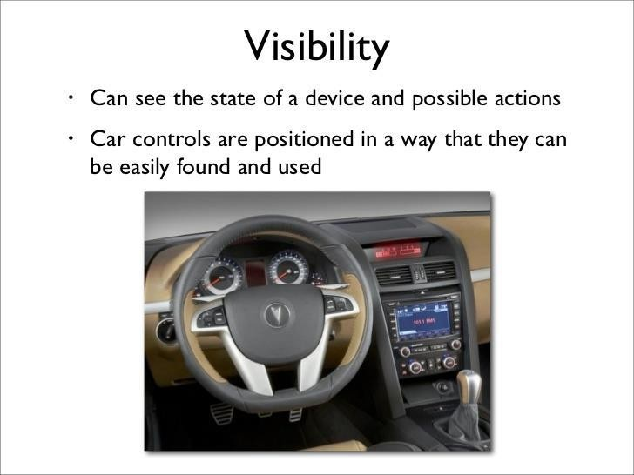
Visibility
6

Slide 7
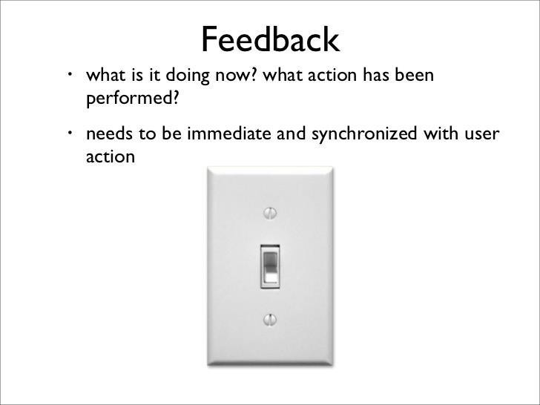
Feedback
7

Slide 8
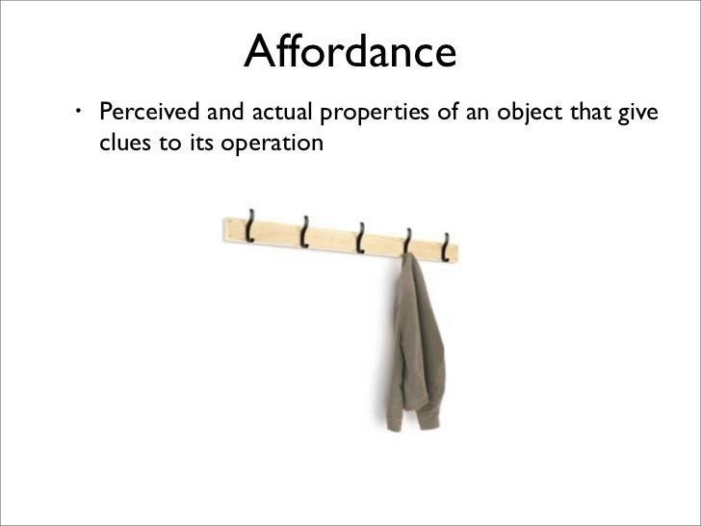
Affordance
8

Slide 9
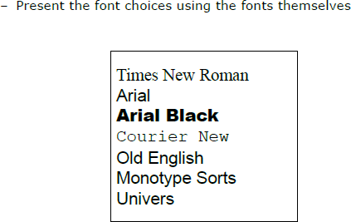
Mapping
9

Slide 10
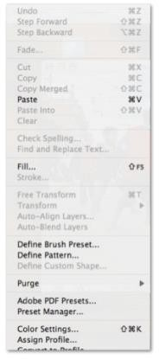
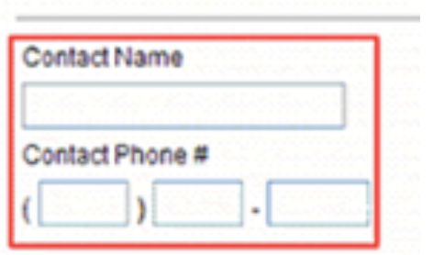
Constraints
10

Slide 11
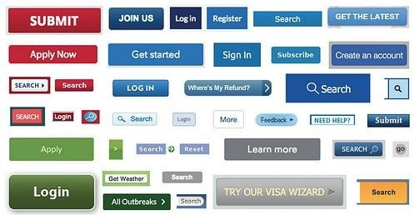
Consistency
11

Slide 12
Requirements
12
All last week's requirements
Allow the user to choose the professional of their choice during his reservation
Add a payment section where the user must provide their credit card information
Add a Navbar to jump to different sections in your website (Your website should be a one pager)
– Avoid having larger menus and try to group them by categories (If you have many)
Use similar elements (same color, same icon), make the icons visible and have highlighted section/elements in your website

Slide 13
Requirements
13
Add icons to
Services
Experts
Payment
Two other elements of your choice (Make sure to add them in your
README)

Slide 14
Design Principles Requirements
14
Visibility and Affordance
Use tooltips (help the user understand what to provide as information and why)
Make the input fields reactive to click or hover actions (Change the color and/or make the field bigger …)
Constraints
Use regular expressions to regulate input fields for
Phone Number
Credit Card Information
Hide days that are not available in the calendar depending on the day and the professional the user choose (Weekends are greyed out, and the professionals off-days are also greyed out)

Slide 15
Design Principles Requirements
15
Feedback
Give error message if the user input wrong information (Name field can’t
have number for example..)
Any other feedback you see necessary to help the user understand what happens after different actions
Consistency
Choose a jQuery theme related to the look of your website
jQuery themes
Choose icons related to your website feel and aesthetics

Slide 16
Optional Requirements
16
Not much for this lab, but if want, you can improve both implementation, the Hair Salon and the Bike Repair Shop if you did both in the last lab.

Slide 17
Starting point
17
Starting point repository
Rendering of the starting point repo

Slide 18
Submissions
17
Add a pdf document in the brightspace lab section link corresponding to the lab whose submission is due.
In Brightspace, In the Lab submission link.
Submit a pdf document consisting of the following: 1)Group number 2)Group members 3)Link to the GitHub repository
4)Each members contribution.
5)Snapshots of the website created

Slide 19
Questions
18
Any questions???
If you have any question, you can send me an email to TAs

Slide 20
THANK YOU!
20

